Slide 1
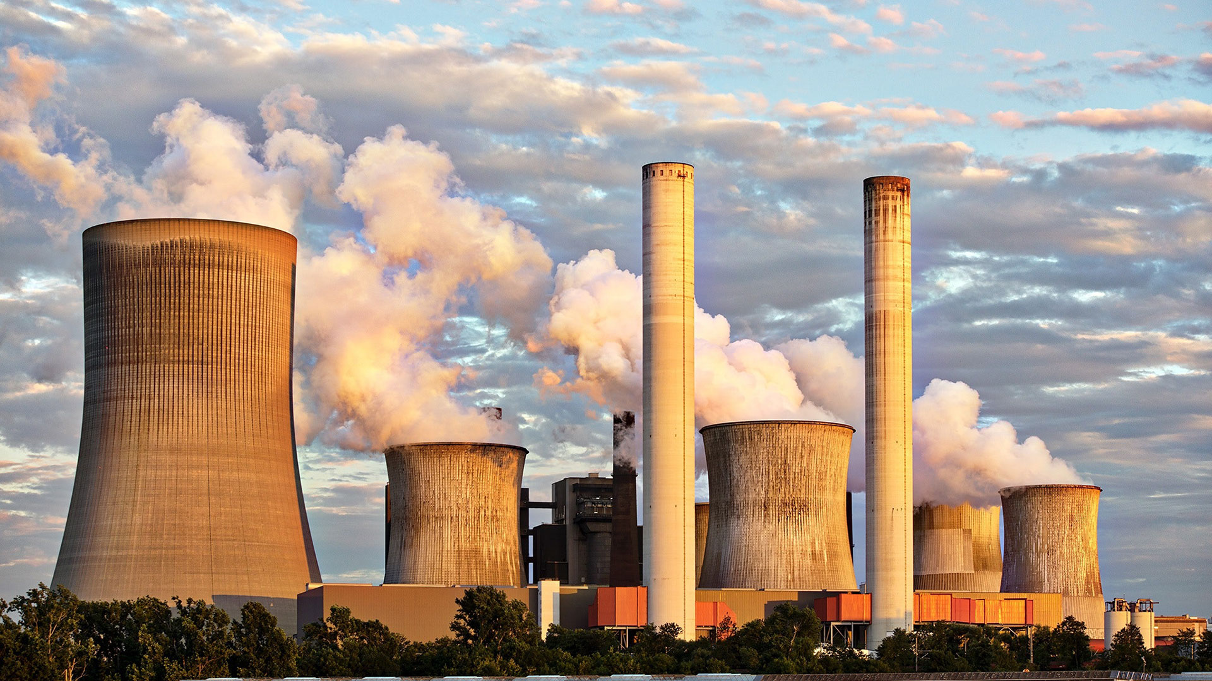
DEATHS DUE TO
AIR POLLUTION
Presented by
Guide By
T. Sandeep
S190812
CSE-2C
N. V. Surya Teja
S190771
CSE-2C
Siva Rama Sastry Sir

Slide 2

01
Death Rates
02
Aim of your Project
03
Requirement techniques
Presentation
Topics
04
Data Set
05
Analysis
06
Conclusion

Slide 3
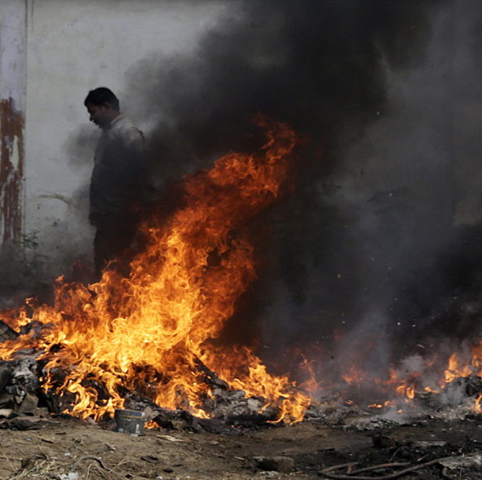
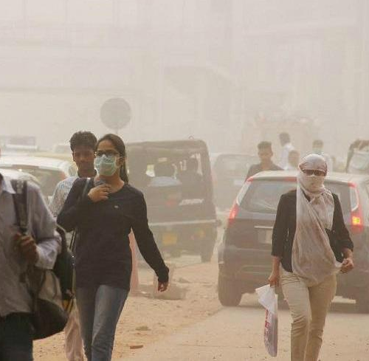
What is Air Pollution ?
It can be a presence of very harmful substance of our Earth atmosphere that can have been effects on human health and all over the living begins.
It’s can been have either natural or human-made Ex:- chemical components , gases , particles matter , vehicles etc…..,
>>>> There are some various reasons for the Air Pollution-related deaths
Lung Cancer
Cardiovascular Diseases [Heart or Blood Vessels]
Indoor Air Pollution
Environmental Disasters
Industrial Accidents

Slide 4
AIM of the project
In recent years, the effect of air pollution on human health have become very critical. The releasing of pollutants into the atmosphere from different sources .
Such as industries , vehicles , and burning fuels , has lead to decreasing the air quality .
There for the project helps to predict the number of deaths due to air pollution in different years .

Slide 5
Requirement for this Project
In this project we used some python popular libraries
NumPy
Pandas
Matplotlib
Seaborn
Scikit Learn
NUMPY :- It can be used to perform a wide variety of mathematical operations on arrays
PANDAS :- pandas is a Python package providing fast, flexible, and expressive data structures
designed to make working with “relational” or “labeled” data both easy and intuitive
MATPLOTLIB :- Matplotlib is a comprehensive library for creating static, animated, and interactive visualizations in Python
SCIKIT LEARN :- Scikit– learn is an open source data analysis library, and the gold standard for Machine Learning (ML) in the Python ecosystem. Key concepts and features include: Algorithmic decision-making methods, including :Classification , identifying and categorizing data based on patterns

Slide 6
DATA SET
CONTEXT:-
Air Pollution continues to be the reason for the killing of Innocent Lives in the world. This data will open your eyes and give to a understanding
our present situation.
CONTENT:-
This data-set contains.
Entity: It contains the name of the country
Code: It contain Code of the country
Year: Years range from 1990 to 2017
Air pollution (total) (deaths per 1,00,000) : Contain total death
Indoor air pollution (deaths per 1,00,000) : Contains death due to indoor air pollution
Outdoor particulate matter (deaths per 1,00,000) : : Contains death due to outdoor pollution
Outdoor ozone pollution (deaths per 1,00,000) : Death due to ozone pollution

Slide 7
ANALYSIS
Data Collection and Preprocessing :
Our dataset taken from the Kaggle website. It contains the null values and missing values in code column of the dataset. So, by using pandas drop() function we dropped that column because of that column data not useful for model building. And also removed unwanted columns that are Entity column.
Feature Selection :
The dataset columns divided into dependent(target) variable and independent(predicted) variables. In our model the target variable is Total air pollution death rate column and remaining all the columns are independent variables.

Slide 8
Machine Learning Model :
For this project we used Linear Regression and Random Forest Machine Learning Algorithms. Based on available data we chosen Linear Regression and Random Forest Regressor models.
The Random Forest performed more accurate than Linear Regression model. The advantage of random forest is combines the predictions multiple decisions tree to make more accurate predictions.
Model Training and Validation :
Using train_test_split() function from sklearn module we splited the data into training part and testing part.
The training part was used to train the ML model. In the same way the testing part was used for evaluating the model performance.

Slide 9
Model Performance :
With the help of RandomForestRegressor() we built the model. It preformed with the accurate of 98% in the prediction of deaths.
The absolute error of the model is 75% and also R-Squared of the model is near to 98%.
Limitations :
In some cases the prediction values are incorrect. With the help of cross-validation and Engineering features to improve the performance of the model.

Slide 10
CONCLUSION
In this project , Our aim is to predict the future death predictions using Random Forest Machine Learning Regression Model based on available data.
This project had to predicted the deaths due to air pollution with the accuracy of 98% , which is an excellent measurement to predict the death.
By this project we can create awareness among the people about the Deaths Due To Air Pollution.
This project is useful for environmental committees to make major actions on pollution.

Slide 11
THANK
YOU

